Slide 1

Birkbeck OP R Training Day 2:
Doing research with R
3 May 2022
Thanks to RStudio Education for many of the slides!

Slide 2
Your Turn
Form new groups of ~3 people. Introduce yourself to your group members. Tell them:
Who you are
What methods you currently use in quant. research
What you remember most from yesterday
Your most pressing question for today
05:00
Notes:
But the most important people you will be working with today are seated right beside you

Slide 3
(Experimental) Science
Reproducible workflow
Experiment
Data
Hypothesis
Conclusions
Notes:
In many ways, scientists have always known this. Scientists have a very robust culture for making maps that lead from hypotheses to data. Many scientific articles comprise just this type of map. This system worked very well when data was nearly synonymous with conclusion.
But in the age of data scientists, scientists must follow a chain of reasoning to get from the data to conclusions, and scientists do not provide good maps to lead others through this reasoning.
Part of the difficulty is the number of things that a useable map would need to include. The map would need to include the data collected, the code used to analyze the data, the software used to run the code, and the reasoning that guided the whole process and interpreted the results.

Slide 4
Data Analysis
Experiment
Data
Hypothesis
Conclusions
Notes:
In many ways, scientists have always known this. Scientists have a very robust culture for making maps that lead from hypotheses to data. Many scientific articles comprise just this type of map. This system worked very well when data was nearly synonymous with conclusion.
But in the age of data scientists, scientists must follow a chain of reasoning to get from the data to conclusions, and scientists do not provide good maps to lead others through this reasoning.
Part of the difficulty is the number of things that a useable map would need to include. The map would need to include the data collected, the code used to analyze the data, the software used to run the code, and the reasoning that guided the whole process and interpreted the results.

Slide 5
Data Analysis
Data
Data
Experiment
Visualize
Transform
Model
Hypothesis
Conclusions
Notes:
In many ways, scientists have always known this. Scientists have a very robust culture for making maps that lead from hypotheses to data. Many scientific articles comprise just this type of map. This system worked very well when data was nearly synonymous with conclusion.
But in the age of data scientists, scientists must follow a chain of reasoning to get from the data to conclusions, and scientists do not provide good maps to lead others through this reasoning.
Part of the difficulty is the number of things that a useable map would need to include. The map would need to include the data collected, the code used to analyze the data, the software used to run the code, and the reasoning that guided the whole process and interpreted the results.

Slide 6
Data Analysis
Import
Tidy
Data
Visualize
Transform
Experiment
Model
Hypothesis
Conclusions
Notes:
In many ways, scientists have always known this. Scientists have a very robust culture for making maps that lead from hypotheses to data. Many scientific articles comprise just this type of map. This system worked very well when data was nearly synonymous with conclusion.
But in the age of data scientists, scientists must follow a chain of reasoning to get from the data to conclusions, and scientists do not provide good maps to lead others through this reasoning.
Part of the difficulty is the number of things that a useable map would need to include. The map would need to include the data collected, the code used to analyze the data, the software used to run the code, and the reasoning that guided the whole process and interpreted the results.

Slide 7
Visualize
Import
Tidy
Model
Reason
Communicate
Transform
Program
Notes:
We'll start with visualizing data. I need everyone to be able to visualize their data with confidence. This will make it easier to understand what we're doing when we start transforming data later in the workshop.

Slide 8






(Rough) Agenda
10:00 – 10:30: Recap
10:30 – 12:30: Run linear models
12:30 – 13:15: Lunch
13:15 – 15:00: Multi-level and path modelling
15:00 – 15:30: Version control and reproducibility
15:30 – 16:00: Q&A, feedback and closing

Slide 9
Recap

Slide 10


A language
Writing software

Slide 11
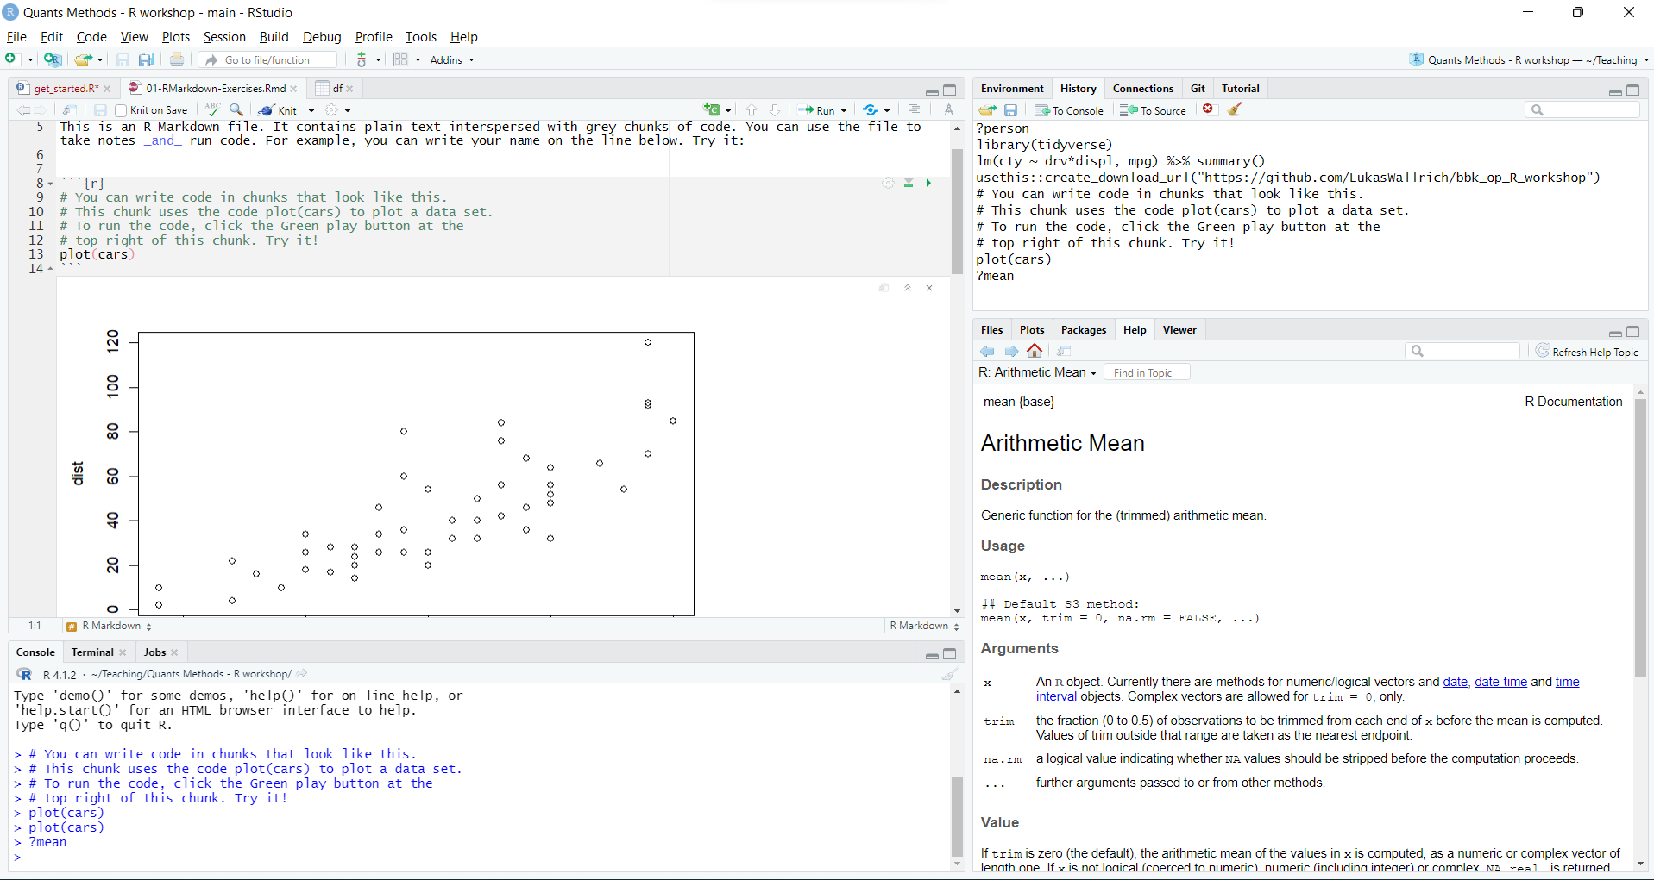

Slide 12
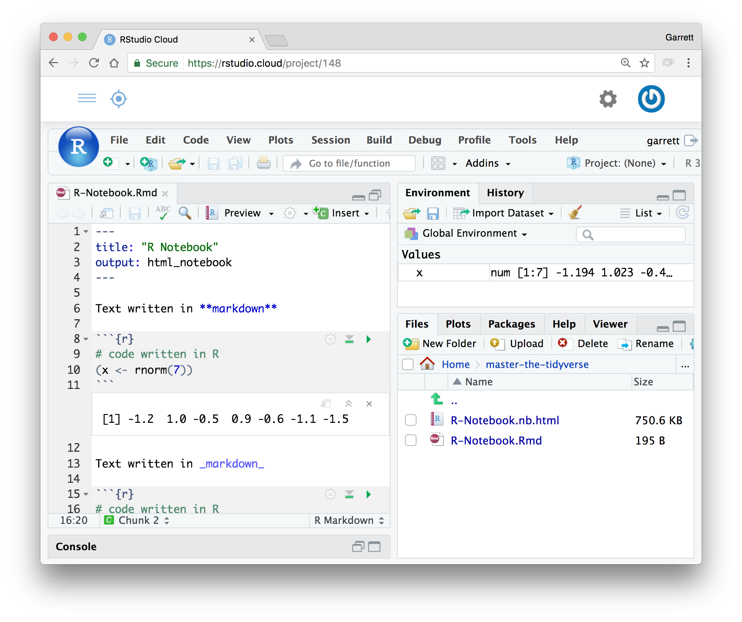
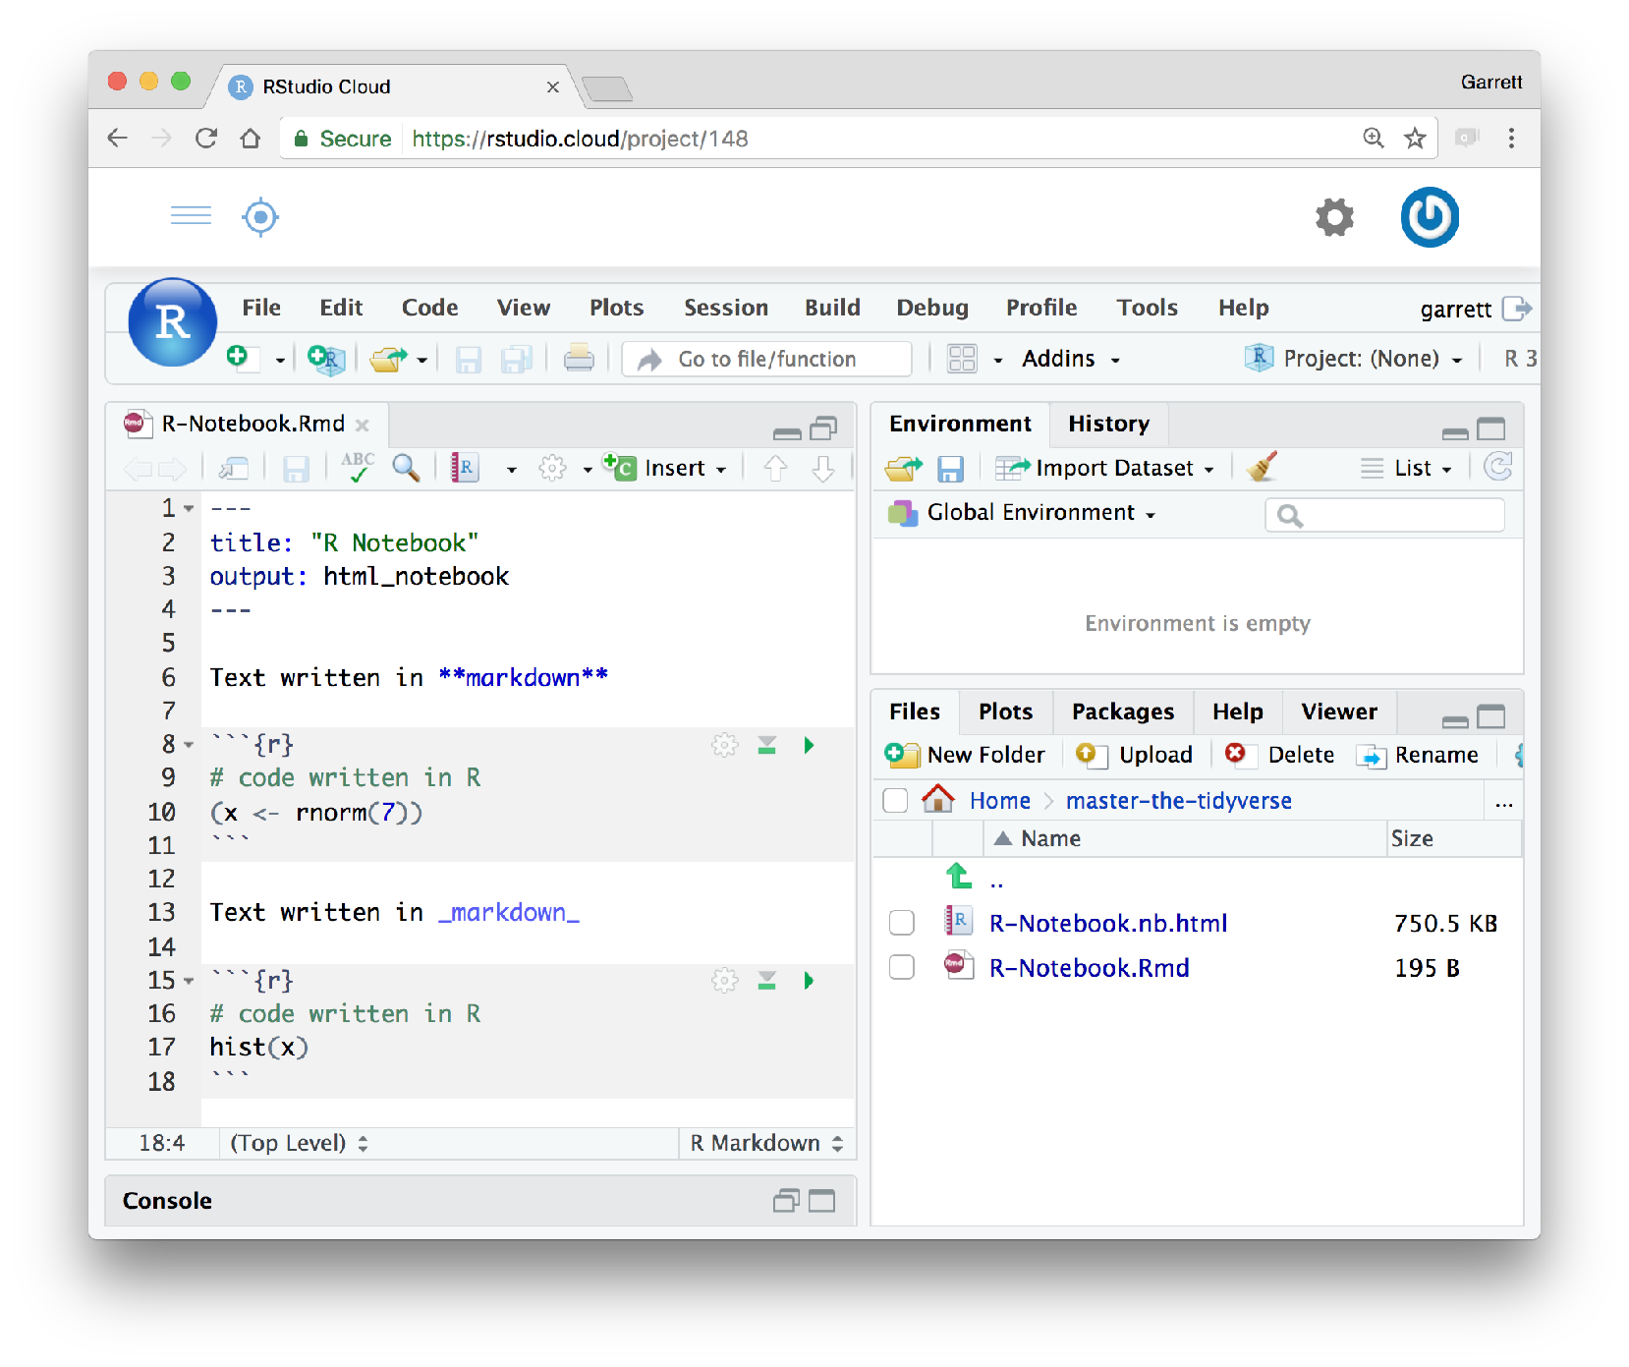
R Markdown
An authoring format for Data Science.
Code, output and interpretation in one place.
Code goes in a chunk
(```{r} to ```)
Click to run code in chunk
Code result
Click on .Rmd file to open notebook

Slide 13

The Tidyverse
Collection of modern R packages that share common philosophies, embed best practices, and are designed to work together.
A dialect of R
Our choice for today!
Notes:
A collection of R packages that are designed to work well together. All of the packages share a common philosophy about how functions should work with each other. And all of the packages are written to support an overarching vision of data science best practices. This network diagram arranges tidyverse packages by their common contributors, which identifies another source of continuity between the packages: they are developed by a coherent group of developers, many of whom are professional R developers who create and maintain the packages as their full time job (not always common with an open source language like R).

Slide 14
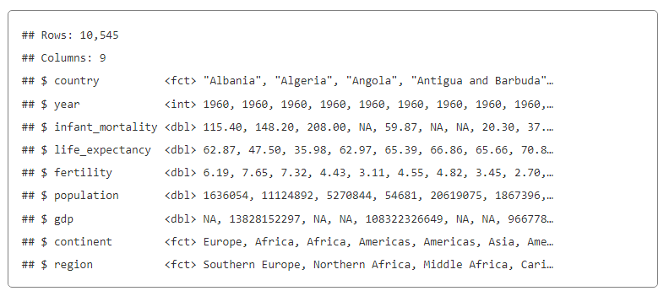
Reading practice 1
gapminder %>%
filter(year == 2010) %>%
mutate(gdp_per_cap = gdp/population) %>%
filter(!is.na(gdp_per_cap)) %>%
group_by(continent) %>%
summarise(avg_gdp_per_cap_nations = mean(gdp_per_cap),
avg_gdp_per_cap_people = sum(gdp)/sum(population)) %>%
arrange(desc(avg_gdp_per_cap_nations))

Slide 15
Reading practice 2
gapminder %>%
filter(year %in% c(1960, 1980, 2000, 2010)) %>%
ggplot(aes(x = gdp_per_capita, y = life_expectancy,
color = continent, size = population)) +
geom_point() + geom_smooth(aes(color = NA, size = NA)) +
facet_wrap(vars(year)) + theme_bw() +
labs(title = "The past 50 years: Greater wealth and greater health”,
x = "GDP per capita (USD/year)”, y = "Life expectancy")

Slide 16
Your Turn
Open 02-Model-Exercises.Rmd
16

Slide 17
Get the materials
Install git, fork and create new project from repository
Go to LINK, click green “Code” button, then download Zip and extract in folder

Slide 18
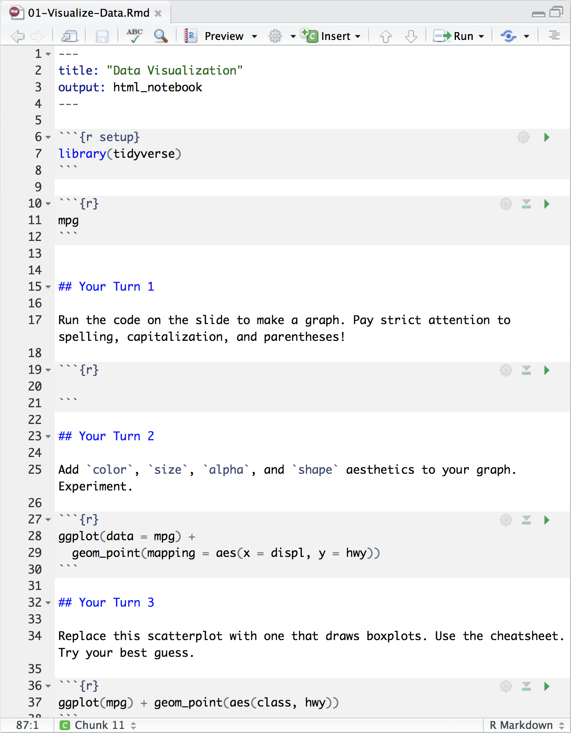
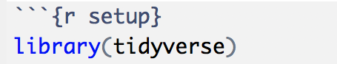
Setup
The setup chunk is always run once before anything else
Chunk labels are optional, the setup label is special

